Slide 1
PC2135
Introductory Lecture

Slide 2


Introducing me!
Angeline Shu (call me Angeline!)
Lecturer in Physics Department
Office: S16-08/S13-02-07
Email add: physhua@nus.edu.sg
More about me:
Graduated (Bachelors) from NUS in 2011 with
a degree in Physics
a minor in Philosophy
under the University Scholar’s Program (USP)
Obtained my PhD in Physics in Dec 2021
Have a 6-year old and a 3 year old!

Slide 3
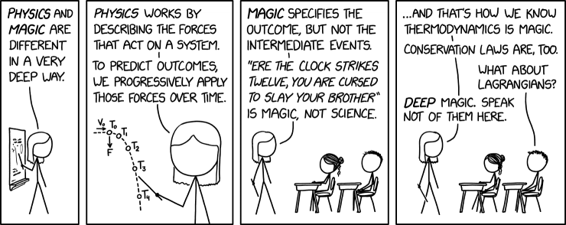
Introducing me!
Courses I teach:
PC2135 (First run for me!)
HSI2011 (Next sem, first run for me!)
HSI1000

Slide 4
Introducing the Topic!
Aim: Describe and predict properties of macroscopic system.
Thermodynamics: With macroscopic quantities like energy and entropy via simple laws.
Statistical Mechanics: By applying known laws of mechanics on each microscopic atom and utilizing statistical tools to simplify formulation.
Intuitive
Underlying process

Slide 5
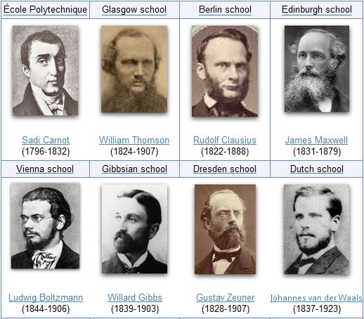
History of Thermodynamics and Statistical Mechanics

Slide 6
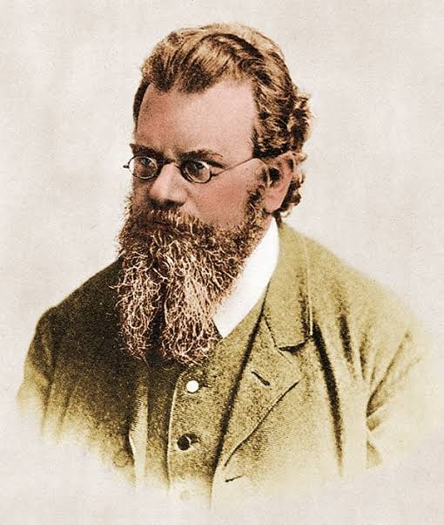
Introducing the Topic!
Notes:
Science is human and difficult sometimes

Slide 7
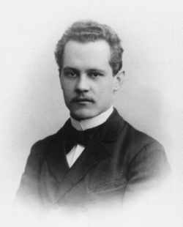
Introducing Thermodynamics
“Thermodynamics is a funny subject. The first time you go through it, you don't understand it at all. The second time you go through it, you think you understand it, except for one or two points. The third time you go through it, you know you don't understand it, but by that time you are so used to the subject, it doesn't bother you anymore.”
Arnold Sommerfeld
Notes:
Heisenberg, pauli, debye were his phd students

